Slide 1
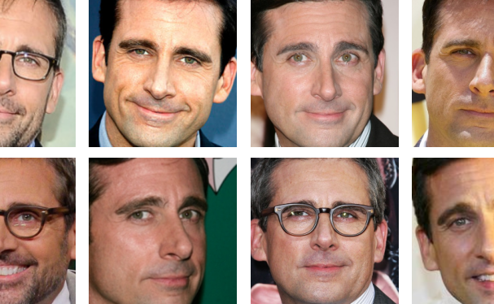
Final Project:
Celebrity Recognition
Sam Greenfield
Group 14
CSCI-B 457

Slide 2
1.
Problem Space
2.
Pipeline
3.
Adjustments
4.
Results
5.
Future Improvement

Slide 3
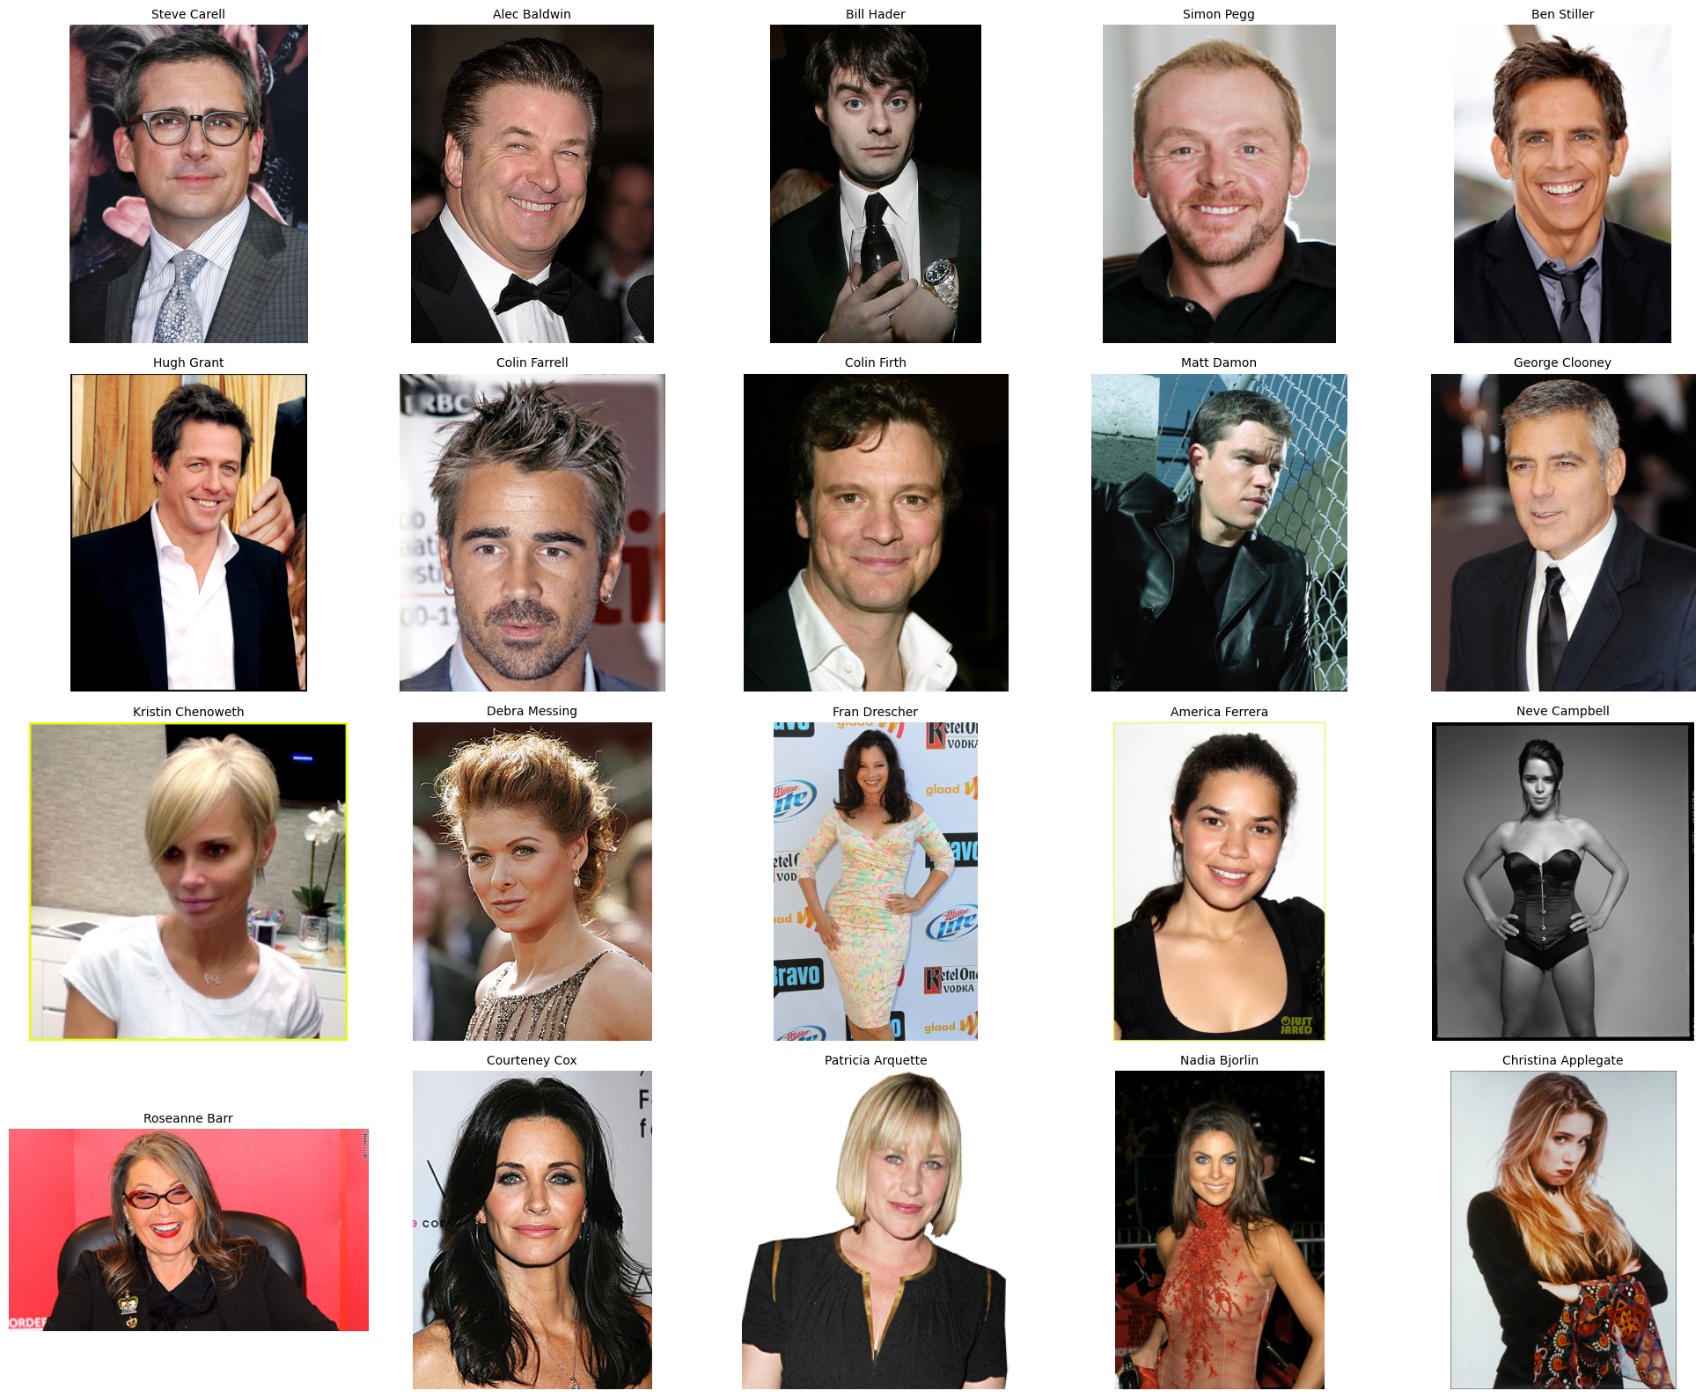
Problem Space
Goal: Build a program which can learn the faces of celebrities and identify them by name.
Goal qualities:
Relatively easy to use
Adaptable to alternate datasets
Reasonably fast
Accurate enough to be useful (>70% accuracy)

Slide 4
Pipeline
Download training data
Extract HOG Features
Download database of images
Determine subset of database to use (based on number of classes to train)
Extract HOG Features from each training image
Train a one-vs.-rest classifier for each class based on the feature vectors within the class
Extract HOG features from test image
Run each classifier’s decision function on test features
Identify the image as that of the classifier with the highest confidence score
Train classifiers
…
C₁
C₂
C₃
C₄
C_{n-1}
C_{n}
Test Results
[v₁, v₂, v_{3,} v₄, … v₃₄₅₉₆], v₂, v₃, v₄, …, v_{n-1}, v_{n}
Get testing data
Extract HOG Features

Slide 5
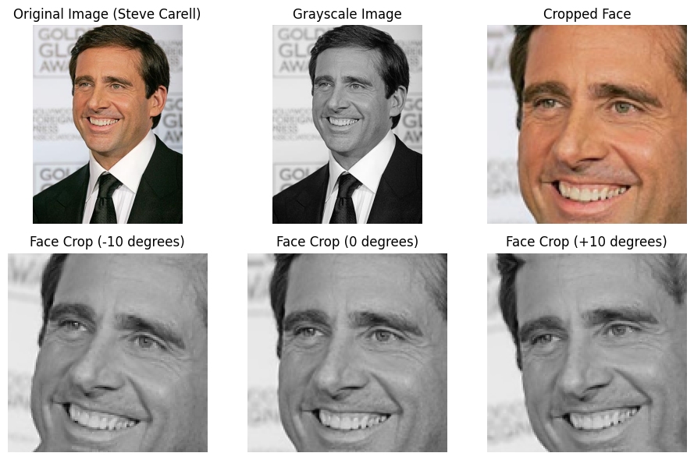
Adjustments
HOG features computed on grayscale image.
Original accuracy was low (~50%, depending classes and amount of data).
So, for each training image,
Convert to grayscale
Use OpenCV frontal face Haar Cascade to crop to face
Rotate -10°, 0°, and 10° and train model on all three angles (tripling training data).

Slide 6
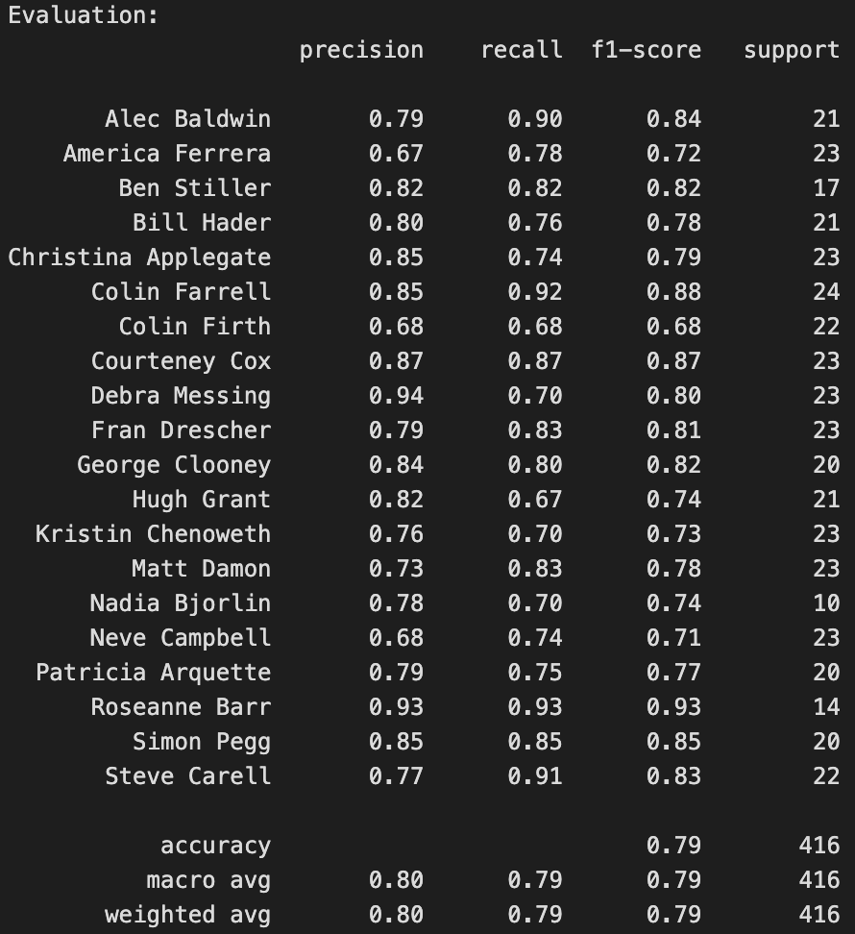
Results
From faceScrub database of labeled celebrity images:
Top 10 actors and top 10 actresses (by number of labeled images) used.
Total 1358 images of 20 classes
2m38s to compute HOG, 11m59s to train and test classifiers
940 training images (* 3 rotations each)
Overall ~80% accuracy run-to-run

Slide 7
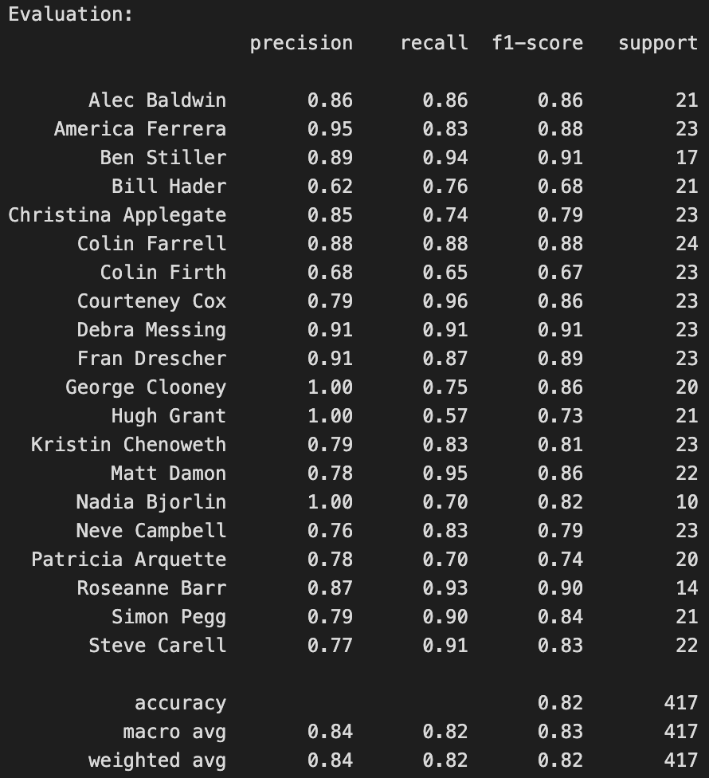
Results
From faceScrub database of labeled celebrity images:
Top 10 actors and top 10 actresses (by number of labeled images) used.
Total 1358 images of 20 classes
2m38s to compute HOG, 11m59s to train and test classifiers
940 training images (* 3 rotations each)
Overall ~80% accuracy run-to-run

Slide 8
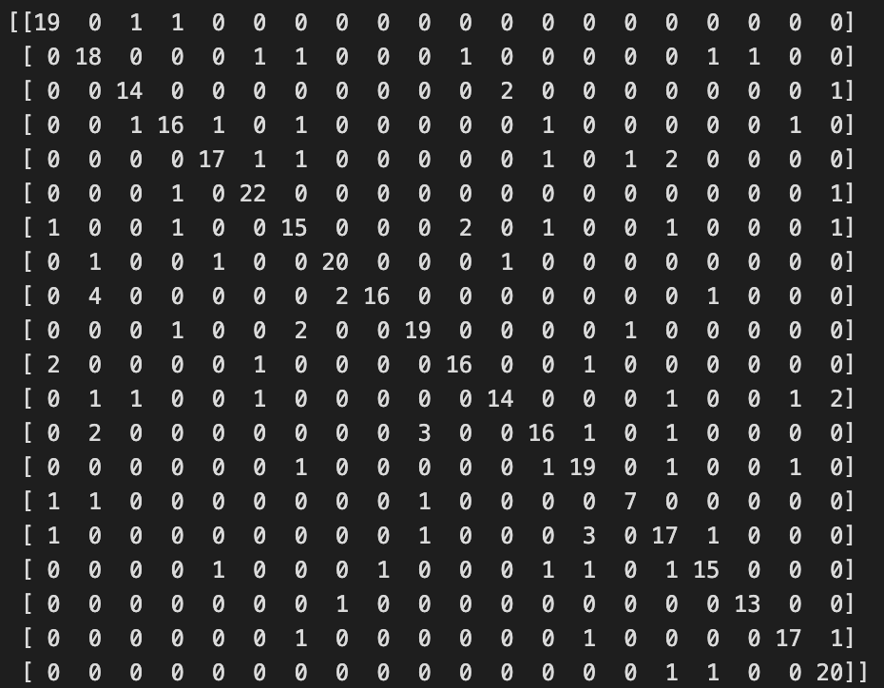
Results
Confusion Matrix:
matrix[row][column] is a count of the number of test images in class {row} which were detected as class {column}
True Positives: Images detected as one class which are of that class (diagonal values)
False Negatives: Images of a class which are not detected as members of that class (values in the same row as the diagonal)
False Positives: Images detected as one class which are not members of that class (values in the same column as the diagonal)

Slide 9
Results
Confusion Matrix:
matrix[row][column] is a count of the number of test images in class {row} which were detected as class {column}
True Positives: Images detected as one class which are of that class (diagonal values)
False Negatives: Images of a class which are not detected as members of that class (values in the same row as the diagonal)
False Positives: Images detected as one class which are not members of that class (values in the same column as the diagonal)
For Steve Carell (class 20):
20 True Positives
2 False Negatives
6 False Positives

Slide 10
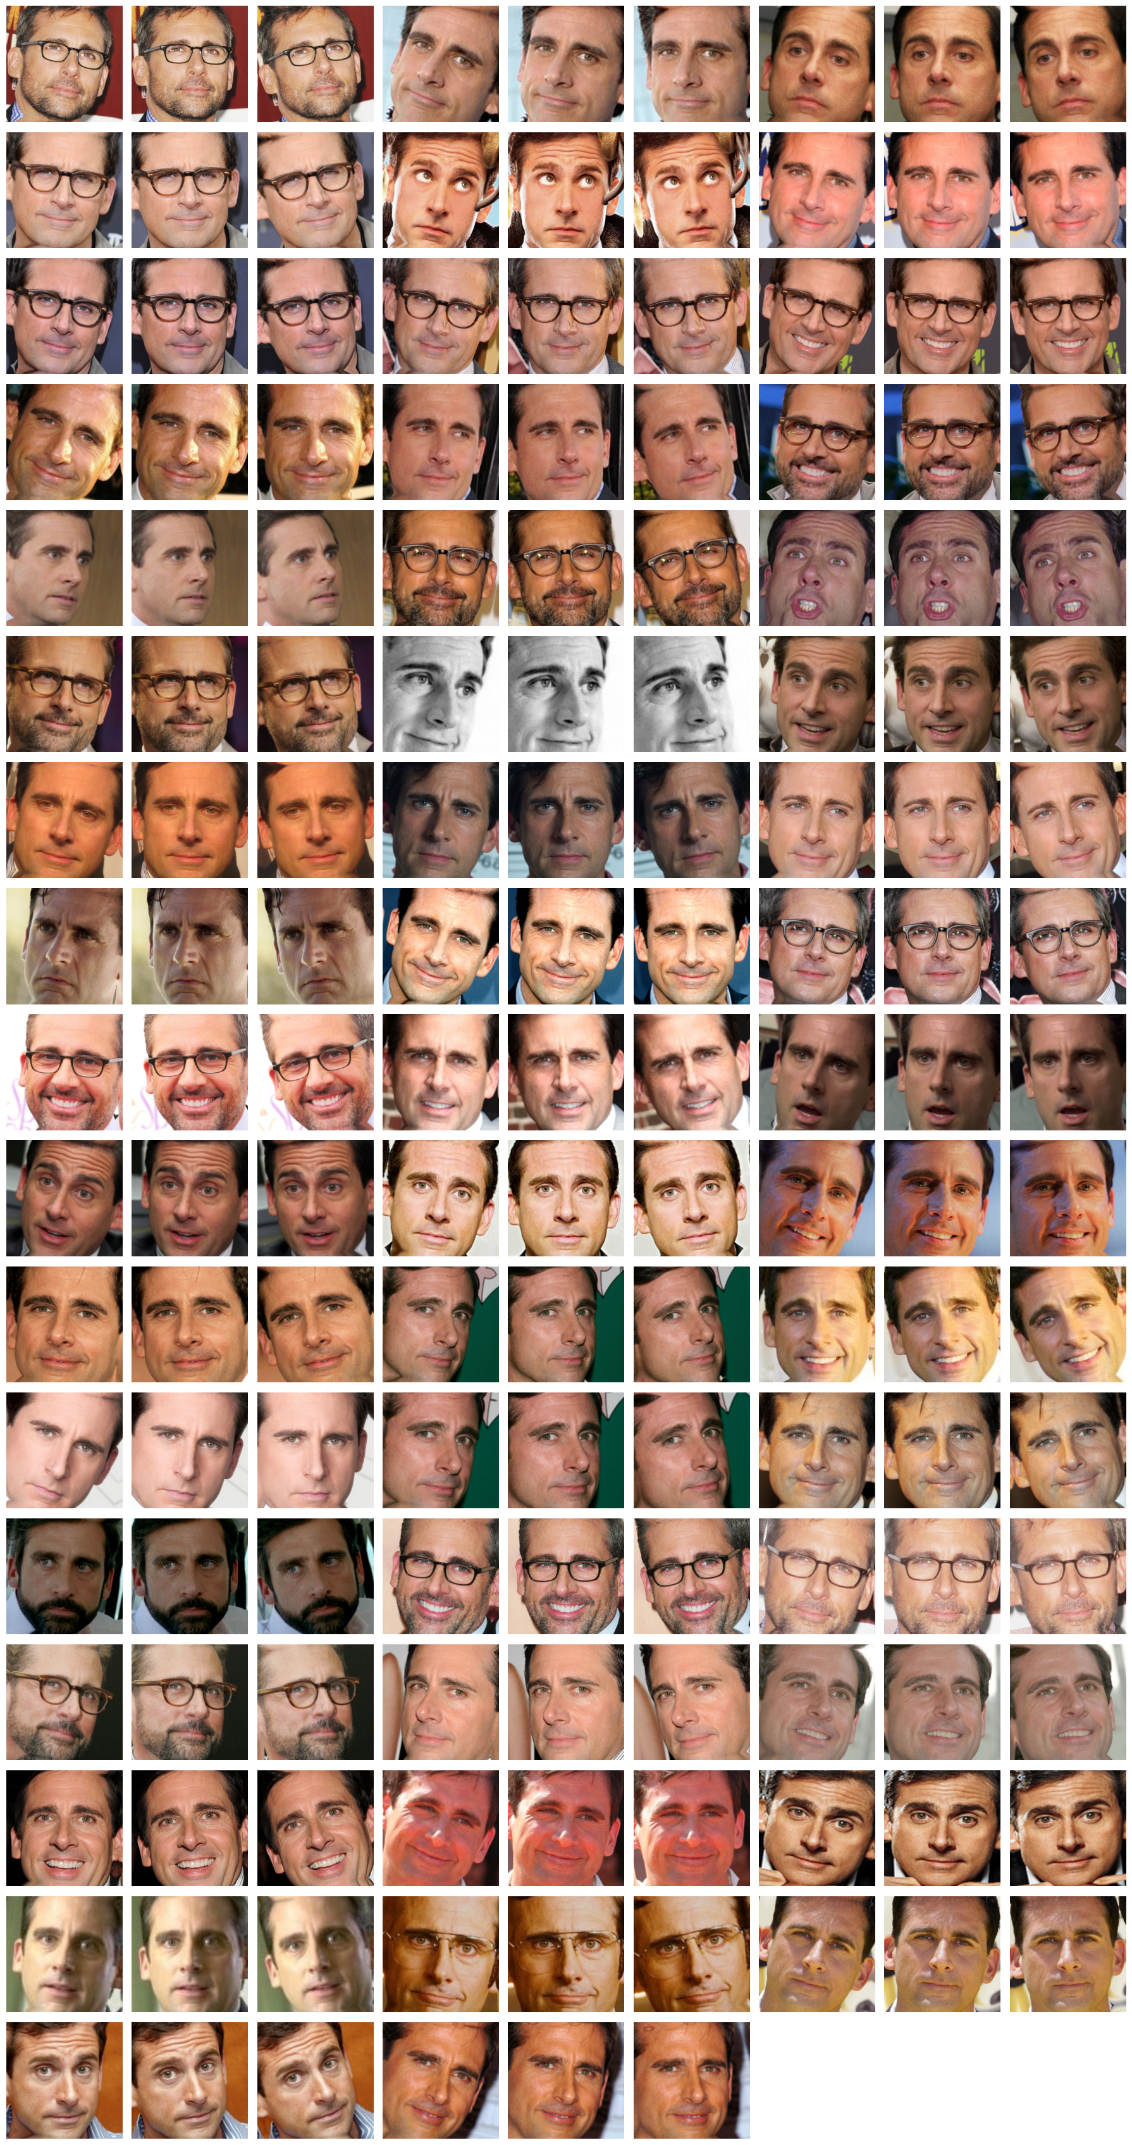
Results
Training set for Steve Carell:
True Positives: Images detected as one class which are of that class (diagonal values)
False Negatives: Images of a class which are not detected as members of that class (values in the same row as the diagonal)
False Positives: Images detected as one class which are not members of that class (values in the same column as the diagonal)
For Steve Carell (class 20):
20 True Positives
2 False Negatives
6 False Positives
50 individual images
150 images (including rotations)

Slide 11
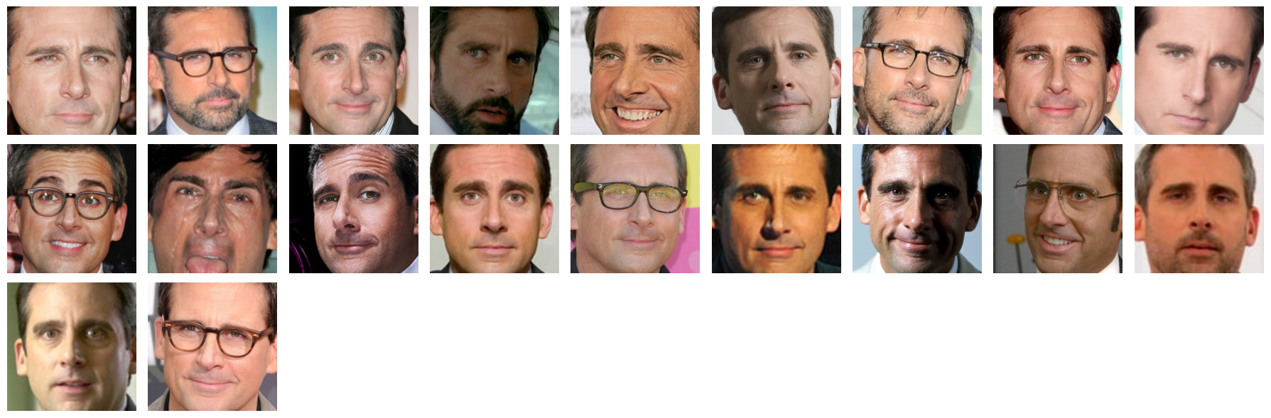
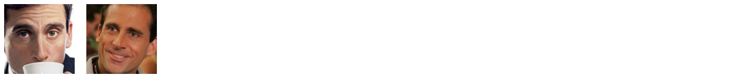

Results
True Positives:
False Negatives:
False Positives:
True Positives: Images detected as one class which are of that class (diagonal values)
False Negatives: Images of a class which are not detected as members of that class (values in the same row as the diagonal)
False Positives: Images detected as one class which are not members of that class (values in the same column as the diagonal)
For Steve Carell (class 20):
20 True Positives
2 False Negatives
6 False Positives

Slide 12
Goals for system
Relatively easy to use
Adaptable to alternate datasets
would have to change code for downloading
Reasonably fast
2m38s to compute HOG
11m59s to train and test classifiers
0.5s to evaluate dataset
Accurate enough to be useful
~80% accuracy run-to-run

